Slide 1

SQA PROJECT
Amazing e-commerce website
Members:
Lê Đức Long - 1801040130
Lý Trung Kiên - 1801040115
Nghiêm Xuân Thủy - 1801040218
Tôn Nữ Tú Anh - 1701040013
Đặng Trần Trung Hiếu - 1701040053

Slide 2
TABLE OF CONTENTS
1. ABOUT AMAZING
2. PROJECT PLAN
3. ACHIEVEMENTS
4. UPCOMING

Slide 3
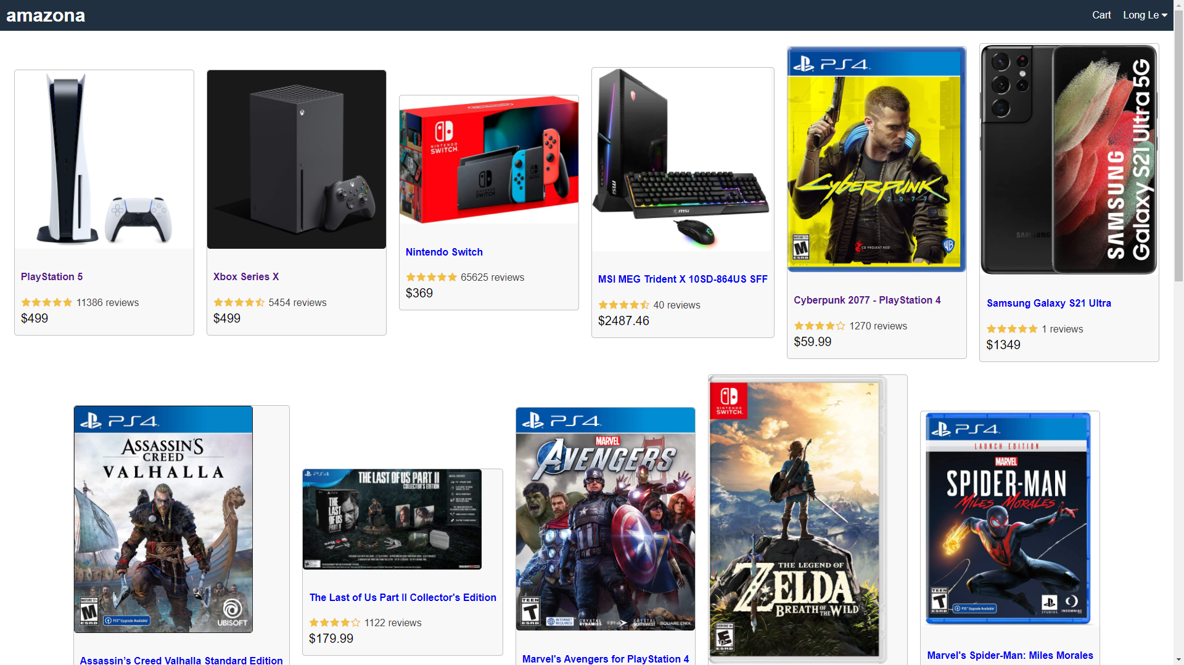
1. ABOUT AMAZING
The main purpose of Amazing is to facilitate buying and selling of products between administrator and customer. It has various functions for store managers and users to achieve this goal.
Administrator are users that are authorized to sell products. They can:
Manage product.
Manage account.
Manage placed order.
Customers are people looking to purchasing products. They can:
Create an account.
Log in, view and edit account details.
Browse all product listings or search for specific product listings.
Add items to cart.
Remove items from cart.
View and update items in cart.
Checkout, select payment method and enter shipping information before placing order.

Slide 4
2. PROJECT PLAN
The goal of this project is to create an e-commerce web application called Amazing, with functions that are close to the Amazon online store. Features include user authentication, product listings management system, browse and search feature for product listings, shopping cart function and checkout procedure.
The web application should be functional and accessible from any device and OS with a browser and internet connection.
The database should be maintained to store and access product and user information.

Slide 5
TOOLS THAT WE USED:
Front end: React.js.
Back-end: Node.js, MongoDB.
Deployment environment: Heroku.

Slide 6

Why use React for frontend?
React has become the first choice
for frontend because it gives developers the ability to
work with a virtual browser (more friendly than the real
browser).

Slide 7

About Heroku:
Heroku is a platform as a service (PaaS) that enables developers to build, run, and operate applications entirely in the cloud.

Slide 8
Backend: Node JS and MongoDB
Node.js lets developers use JavaScript to write command line tools and for server-side scripting—running scripts server-side to produce dynamic web page content before the page is sent to the user's web browser.
About why we chose MongoDB:
Flexible document schemas
Code-native data access
Change-friendly design
Powerful querying and analytics
Easy horizontal scale-out

Slide 9
To satisfied the mentioned requirements, we decided to divide the project plan into 5 phases 1. Requirement specification 2. Analysis and Design 3. Implementation 4. Verification and Validation 5. Deployment 6. Maintenance
Process

Slide 10
Phase 1: Requirement Definition
In this phase, whole group member analyze noted requirements of project in Requirement Description document. This phase help us to consider any limitations and constraints that can affect project development project. The output of this phase should be:
Use case Diagrams and Use Cases Specification
Use case Specification
Entity Relationship Diagram(ERD)
Activity Diagrams

Slide 11
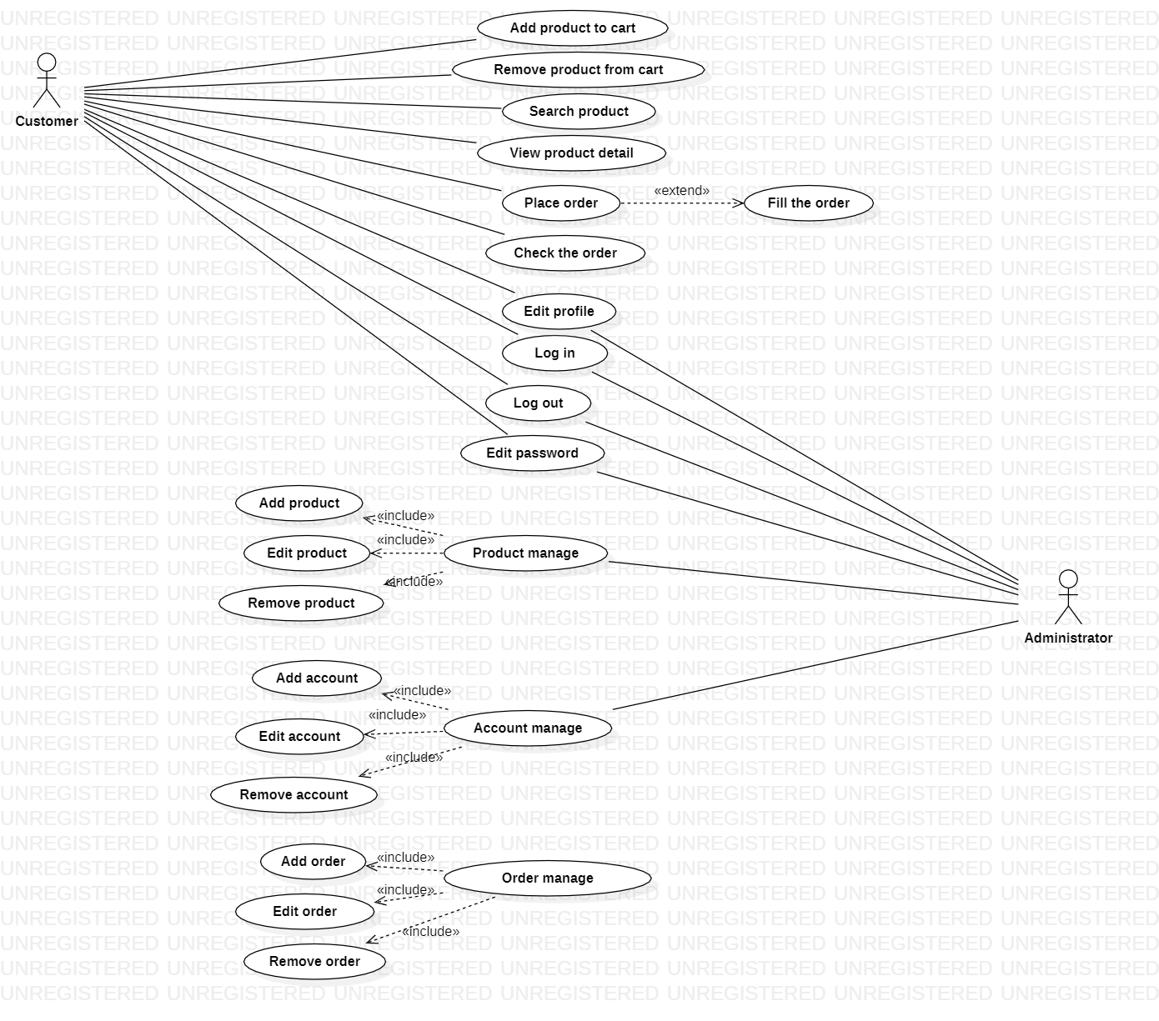
Phase1: Requirement Definition
Use Case Diagrams:

Slide 12
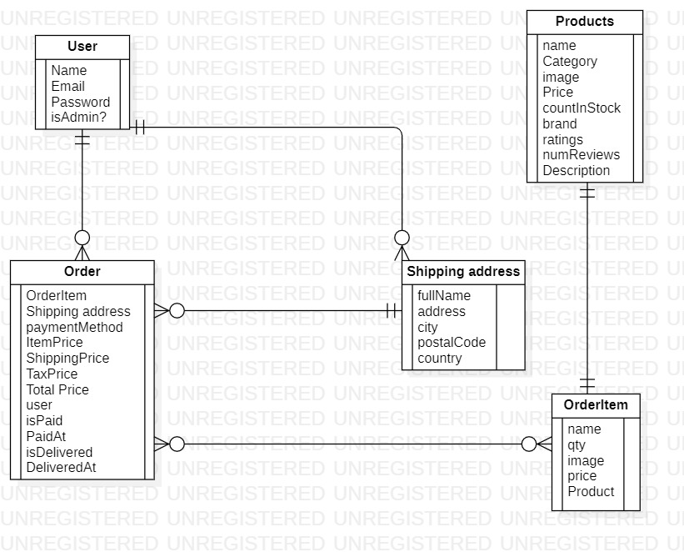
Phase 1: Requirement Definition
ER Diagram:

Slide 13
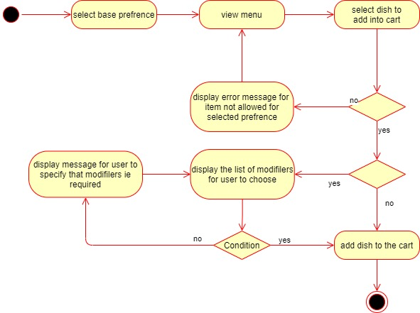
Phase 1: Requirement Definition
Activity Diagram:

Slide 14
Phase 2: Analysis and Design
In analysis and design phase, based on the definition from the first phase, we designed the prototype by using Figma as a tool to represent all functions and drew Sequence Diagrams so that our group member can follow the work-flow easier.
The output of this phase must be:
Mockups & Prototype
UI Design
Class Diagrams
System Architecture Document
Database Design

Slide 15
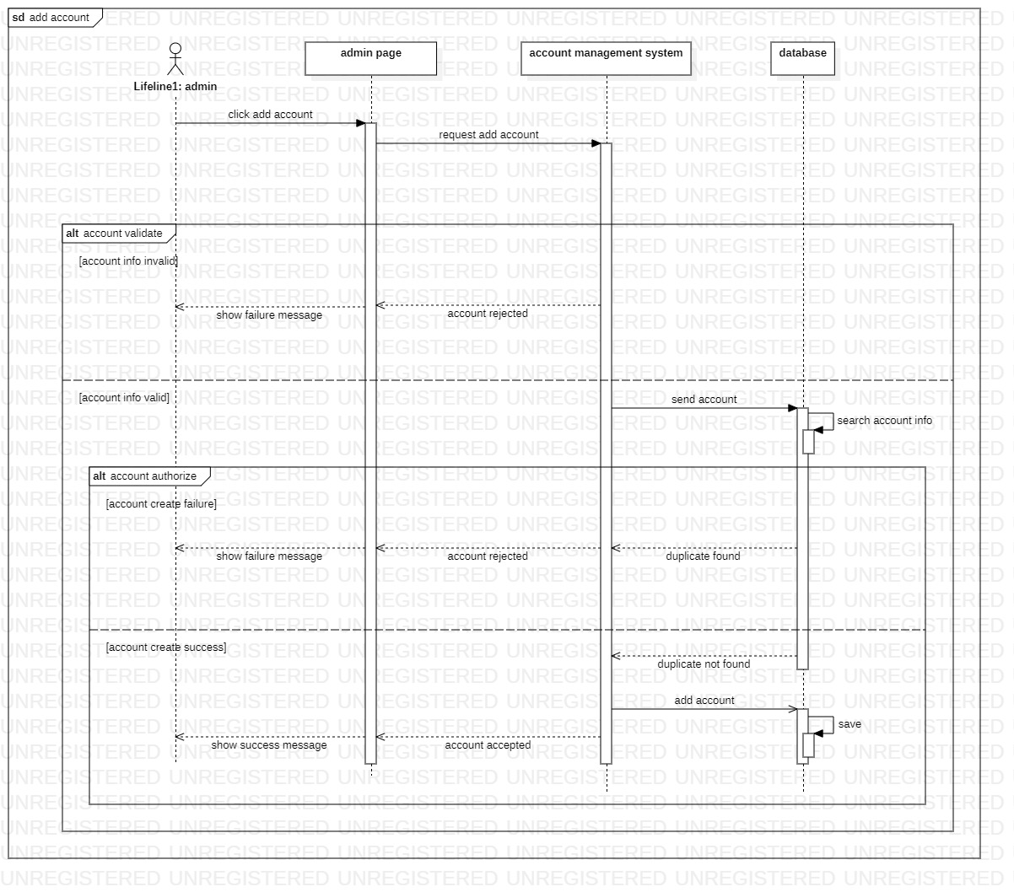
Phase 2: Analysis and Design
Class Diagrams:

Slide 16
Phase 3: Implementation
In implementation phase, base on the features received from the previous phase, we written the source code for the project.
The output of this phase contains:
Back-end code for each requirements by using node.js
Front-end code for user interface by using React.js

Slide 17
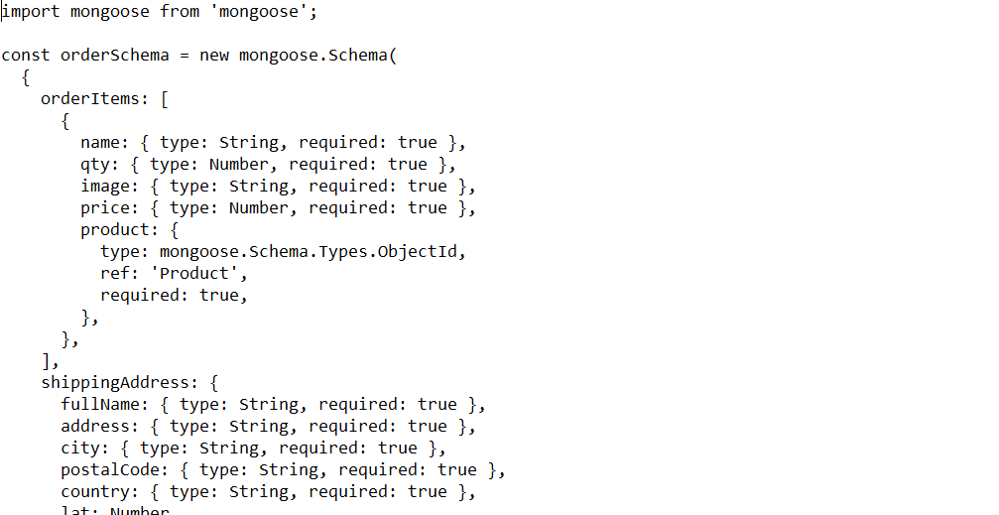
Phase 3: Implementation
Code view: Back-end (orderModel.js)

Slide 18
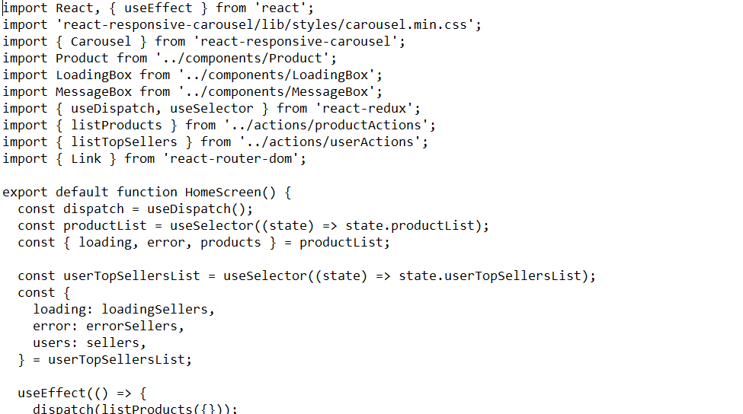
Phase 3: Implementation
Code view: Front-end (HomeScreen.js)

Slide 19
Phase 4: Verification and Validation
Phase 4: Verification and Validation
Source code will be handled by testers in this phase. Testers of our group take responsibility to discover and report the issue in source code. First, a SQA plan would be create. Then, they must test all functions in source code by using Jest or Mocha test for JavaScript and writing test report after finish testing.
The output of this phase must be:
- SQA Plan
Code Inspection Report
Test Case
Test Report

Slide 20
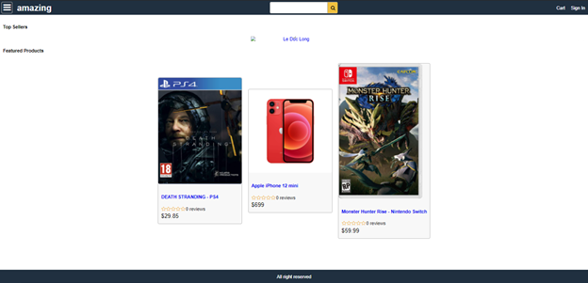
Phase 5: Deployment
In this phase, we use Heroku to deploy the project.
The deployment link is: https://poochswadge-amazing.herokuapp.com/

Slide 21
Phase 5: Maintenance
After deployment phase, we decided to maintain the system every 3 months. Each maintenance should satisfy these requirements:
Maintenance should solve all problem that appear in the system through using time
System down time for maintenance should be less than 300 hours.
After maintenance, make sure that system operation is smooth as much as possible.
After maintenance, make sure that problem happened in the part do not appear again.

Slide 22
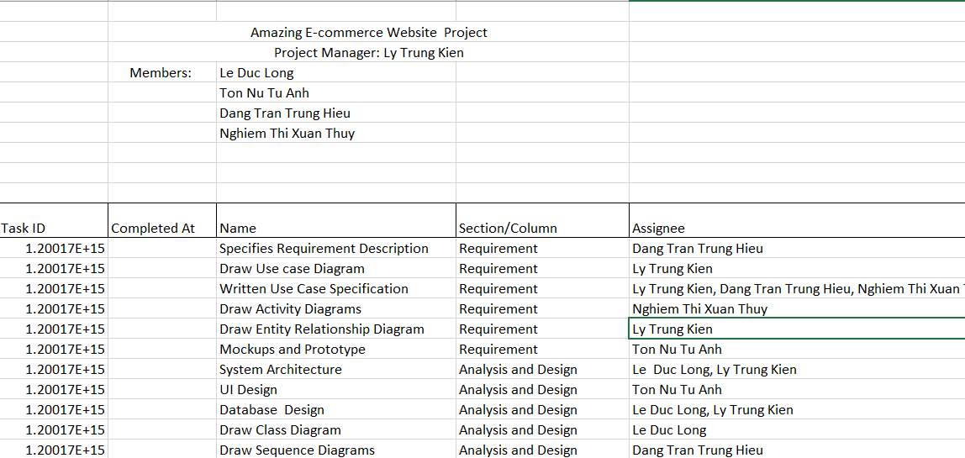
SQA Plan (Asana Auto Gantt chart):

Slide 23
Benefit of Heroku:
Allows the developer to focus on code instead of infrastructure
Enhance the productivity of cloud app development team
Monitor and enhance performance though rich application monitoring
Offers a powerful dashboard and CLI
A bunch of supportive tools
Beginner and startup-friendly
It allows you to create a new server in just 10 seconds by using the interface of Heroku Command Line.
This cloud computing platform takes care of patching systems and keeping everything healthy.

Slide 24
3. ACHIEVEMENTS
So far, we’ve managed to achieve some valuable experience during the process of making an application:
Teamwork is extremely important to get this job done.
Communications between members are vital to complete the objective, especially during the pandemic whilst our team had to work from distance.
The key here is to understand how a website work from backend to frontend, and how all the functions work in real life.
Our team has finished the basics functions that an e-commerce website needs to have. Also, we’ve already planned for the upcoming weeks.

Slide 25
Q&A

Slide 26

THANK YOU VERY MUCH!

